Slide 1
Data Collection from Smart Watch

Slide 2
Outline
Introduction
Sensor Dashboard
Accelerometer and Gyroscope Axis Configuration
Gestures
Values and graph

Slide 3
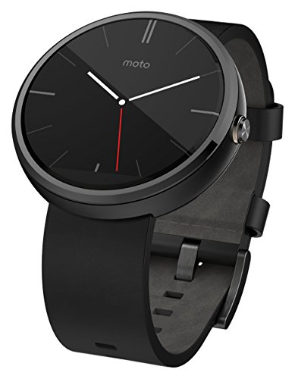
Introduction
Application for the phone : Sensor Dashboard
Smart Watch : Moto 360
Accelerometer and Gyroscope
512 MB RAM
Dust and Water Resistant

Slide 4
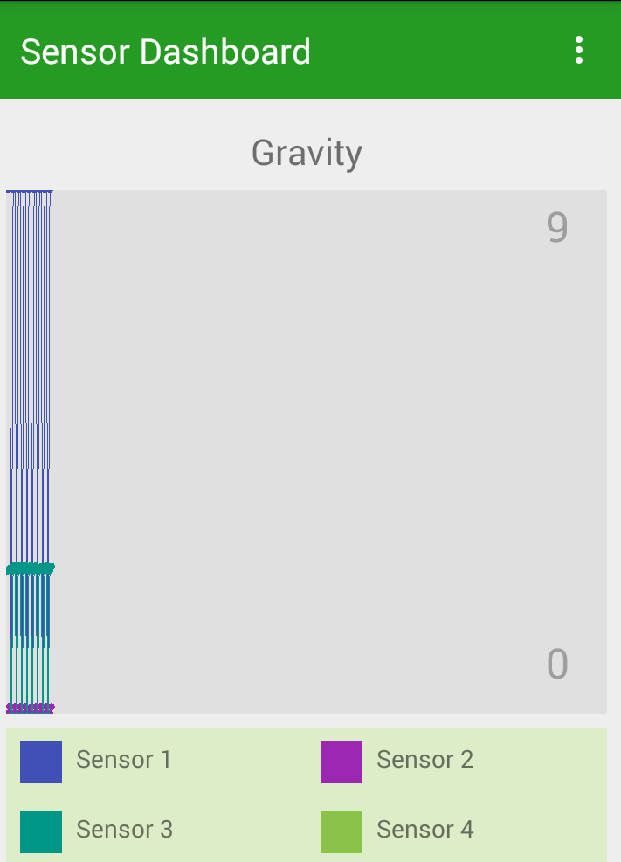
Sensor Dashboard
Application used for gathering data from the sensors in the watch
3 Sensors – Accelerometer , Gyroscope, Gravity
For each axis in sensor different color is used to distinguish them
Blue – Axis 1
Purple – Axis 2
Green – Axis 3

Slide 5
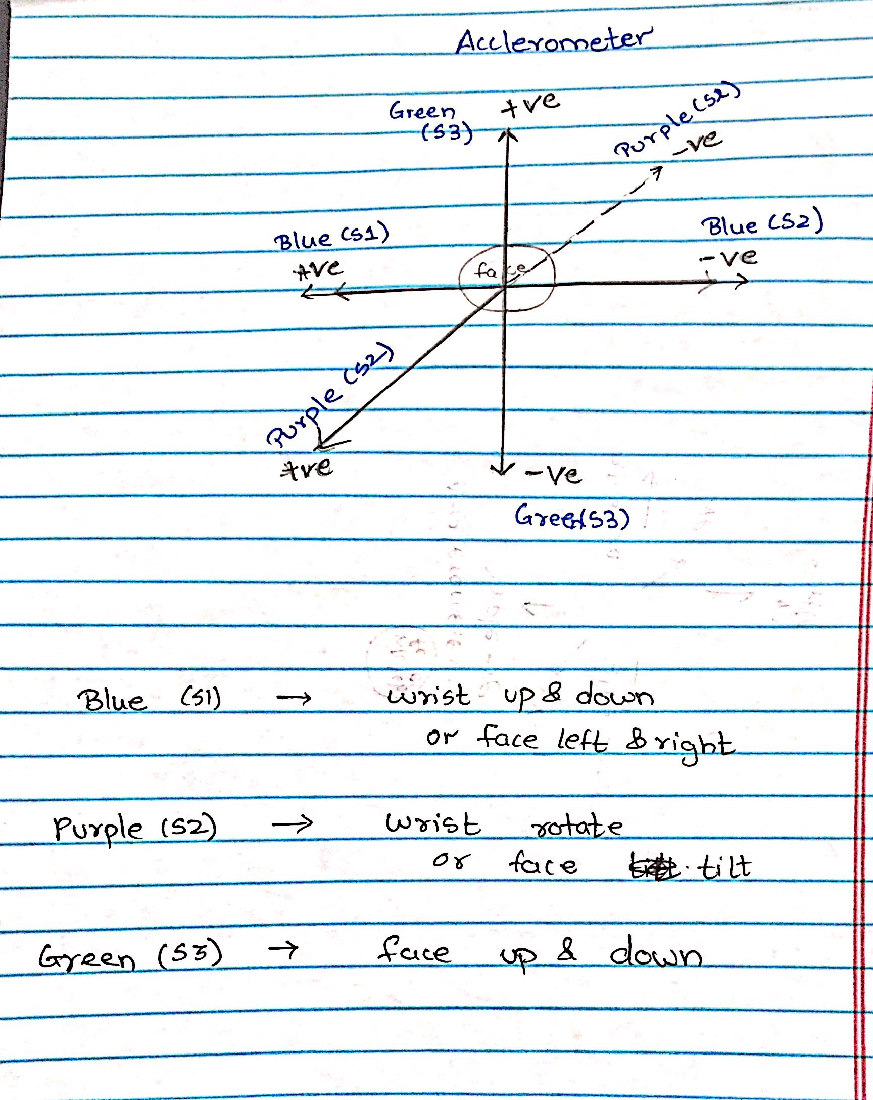
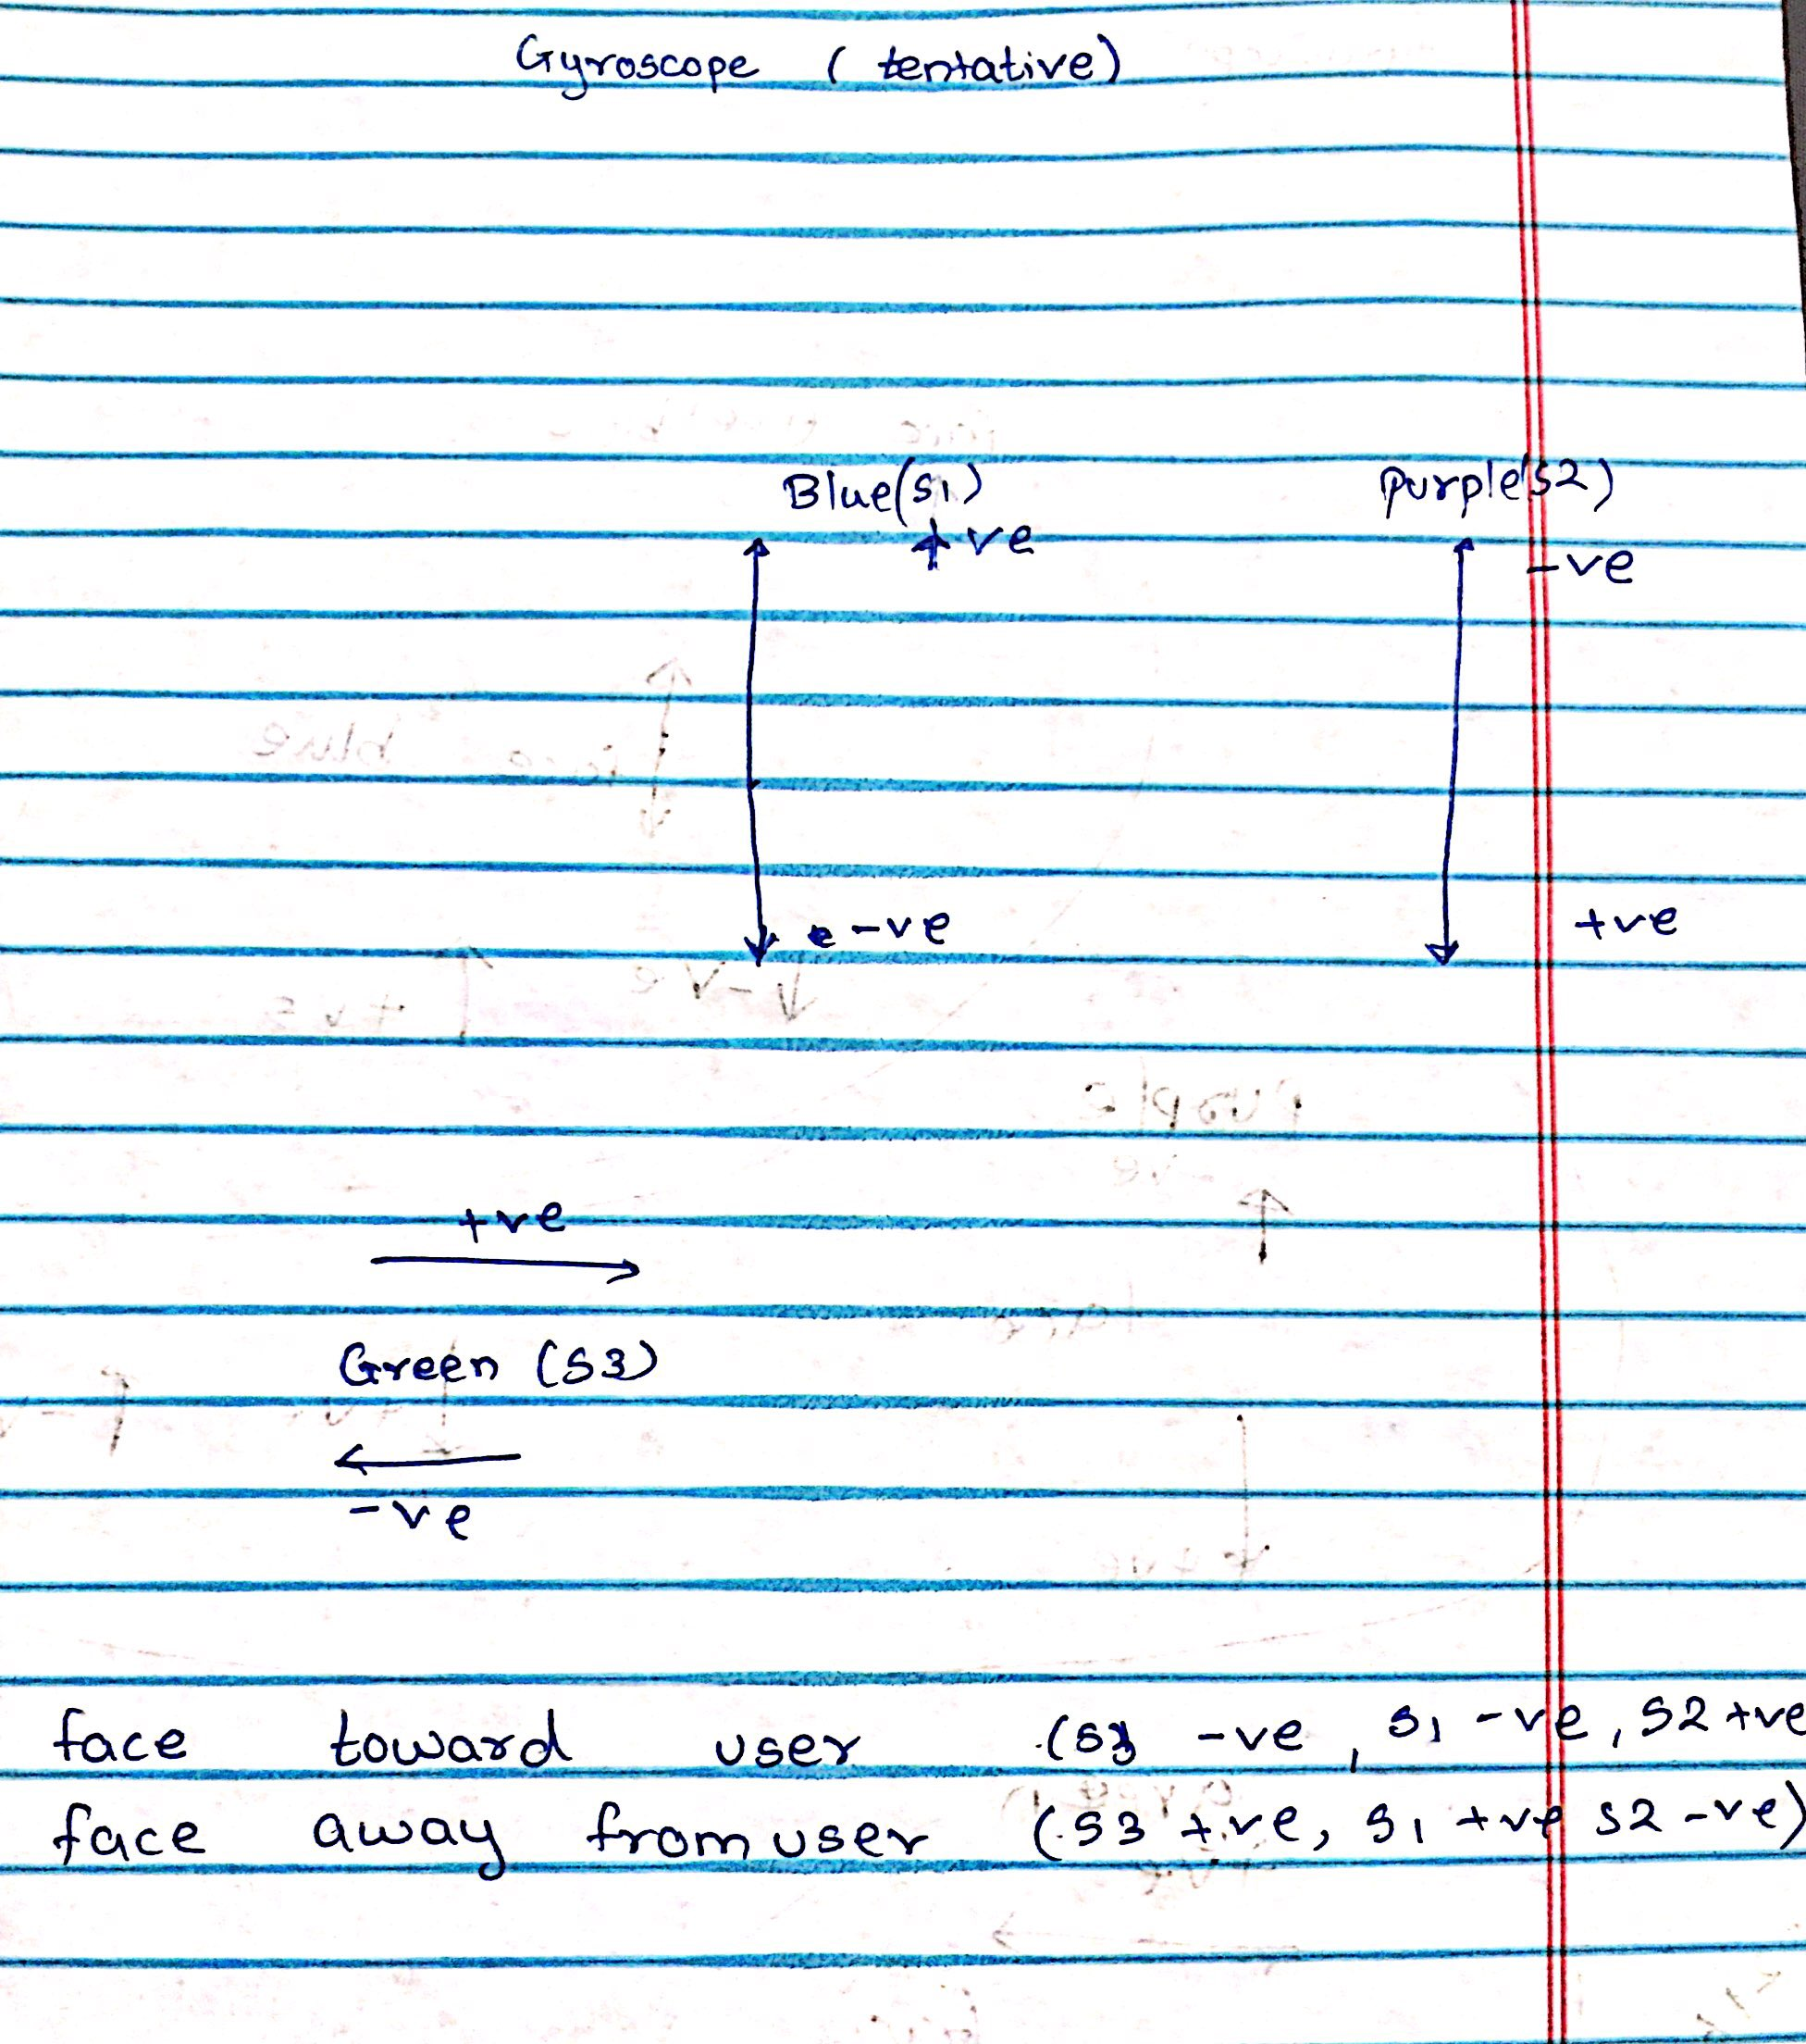
Accelerometer and Gyroscope Axis Configuration

Slide 6
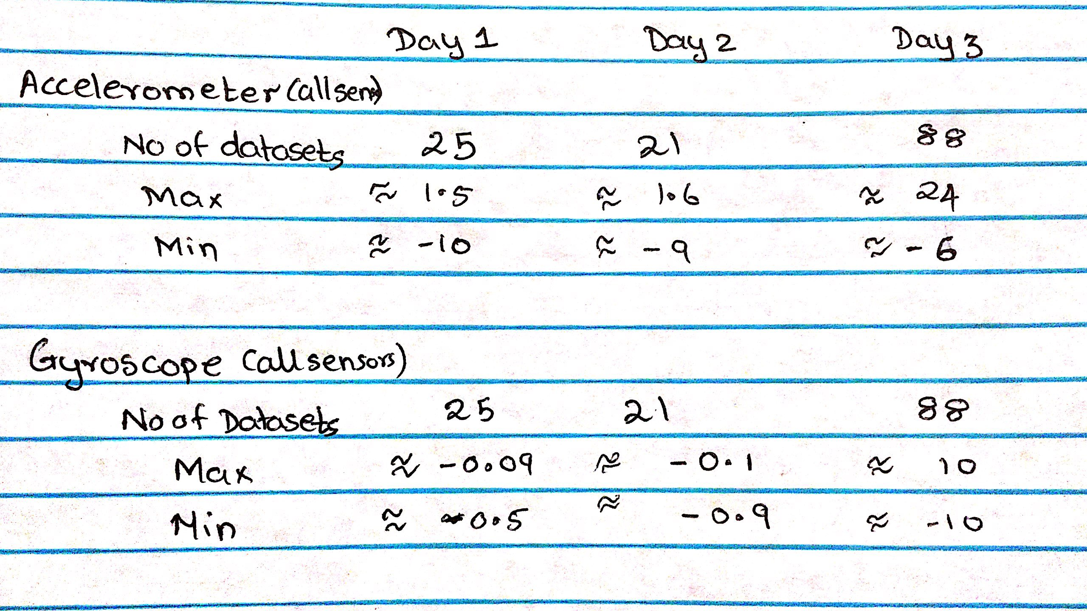
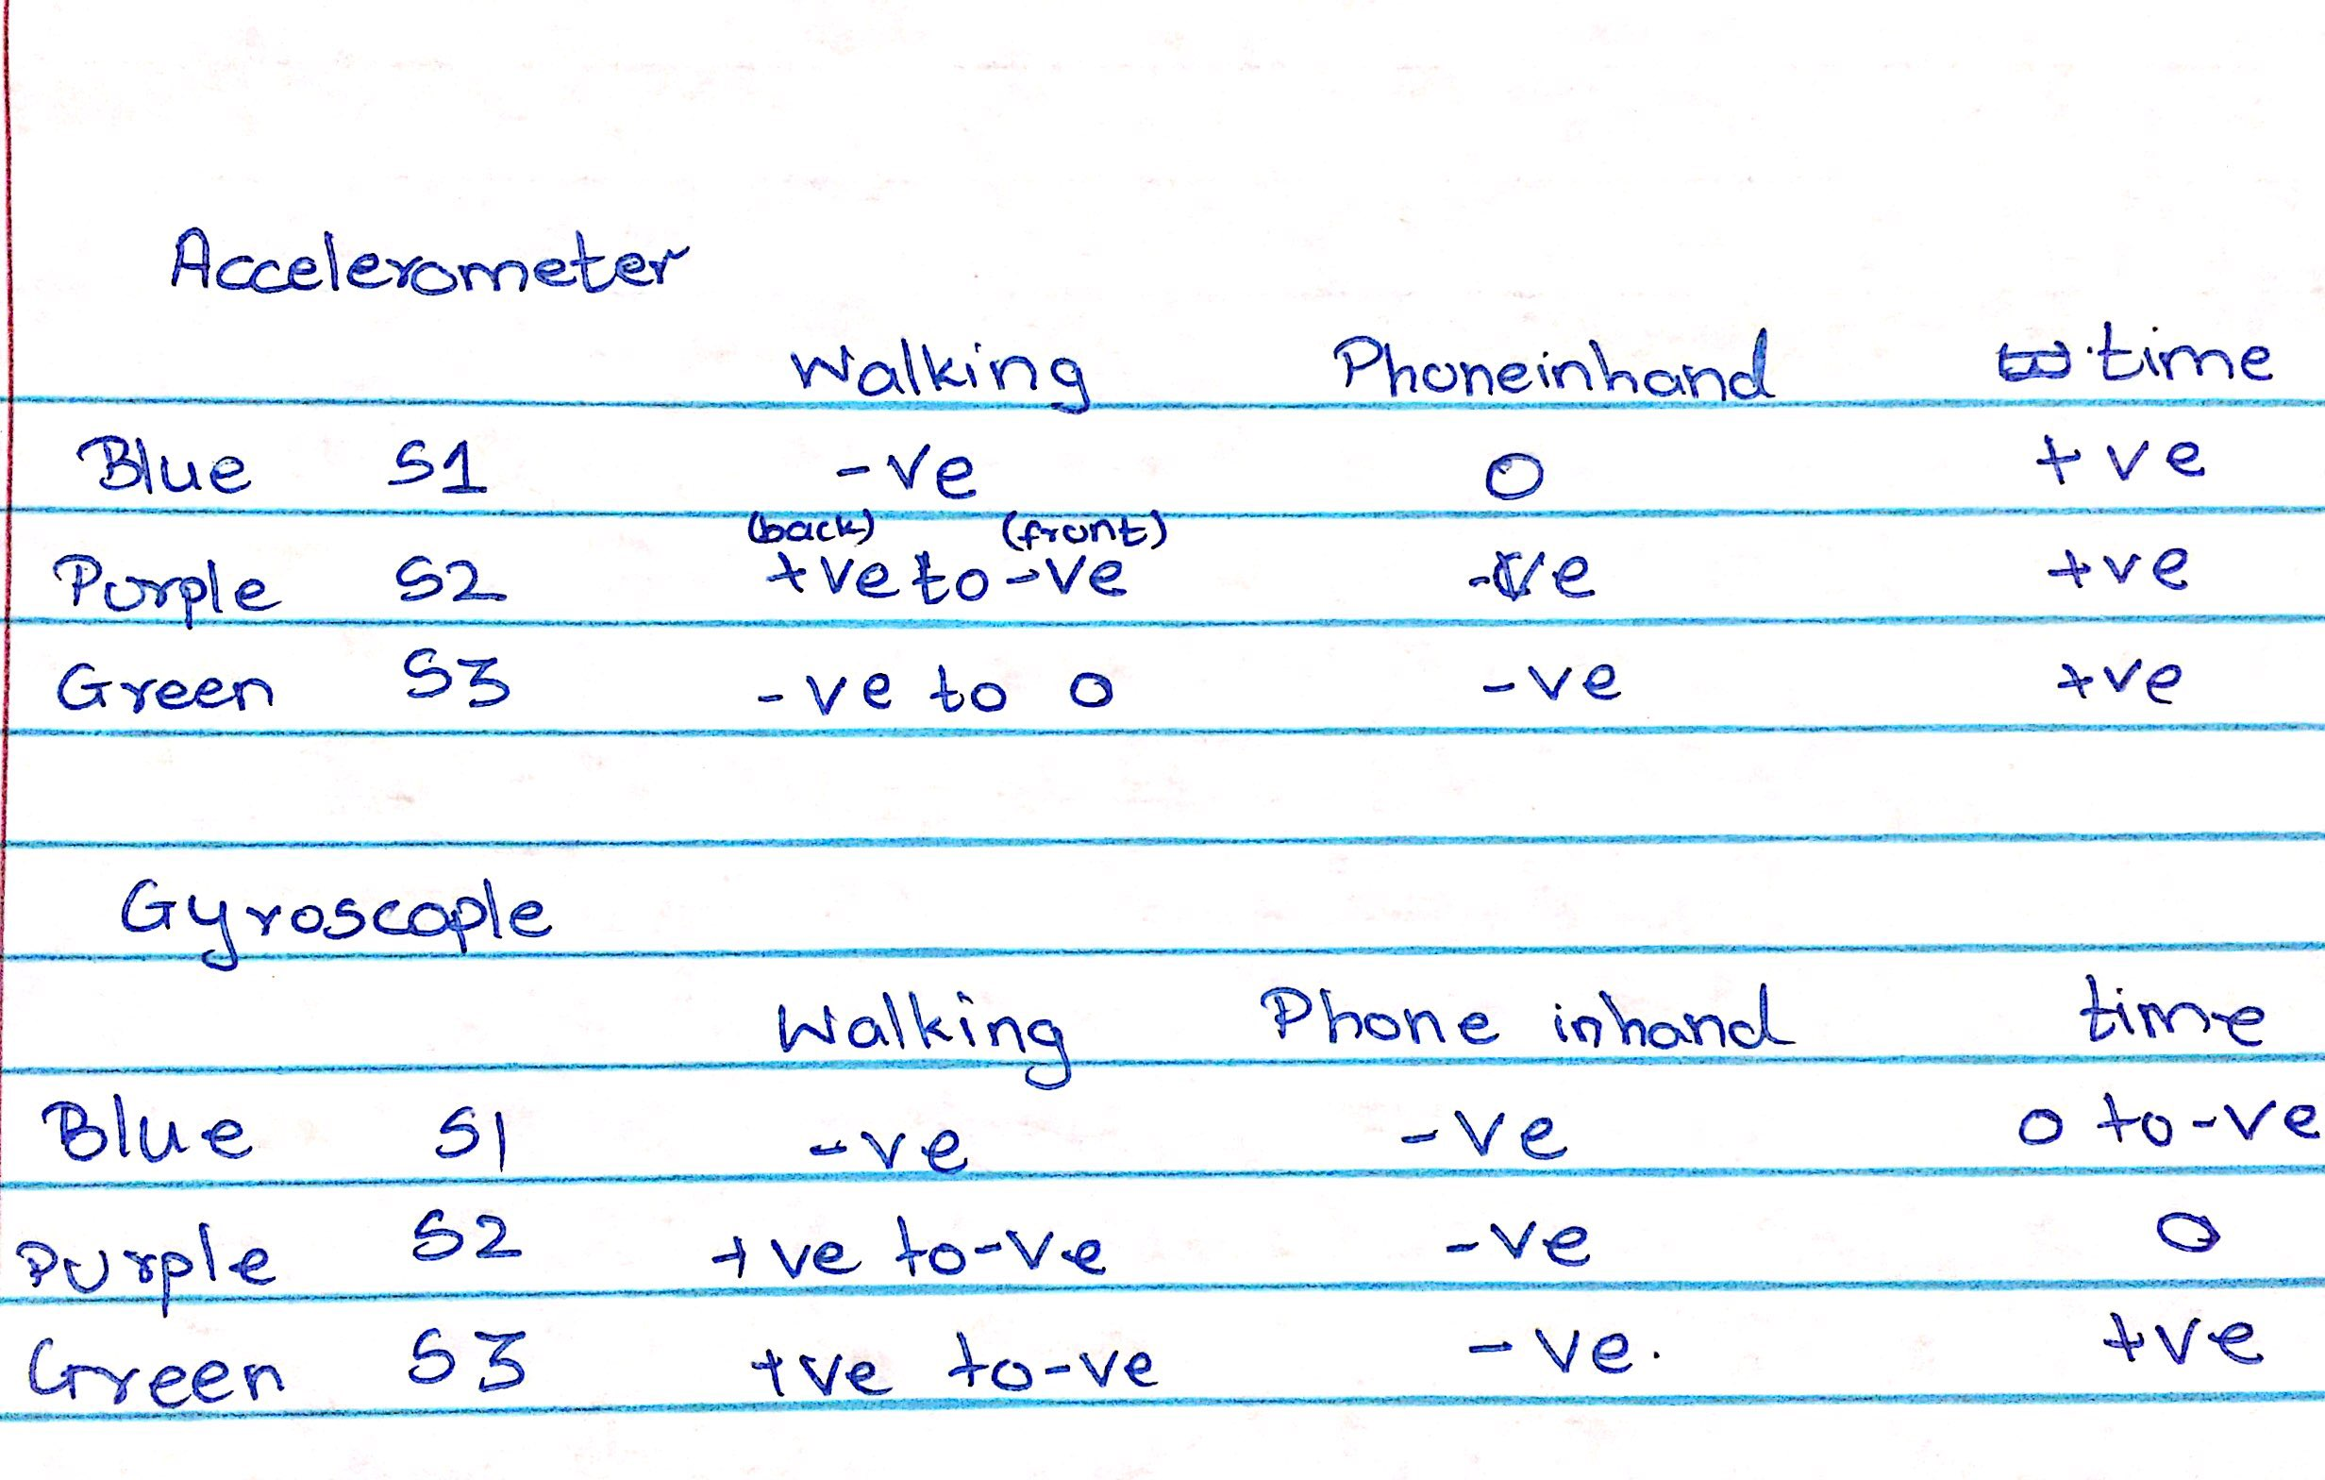
Gestures
Common gestures – walking, seeing time, voice activation, using the phone

Slide 7
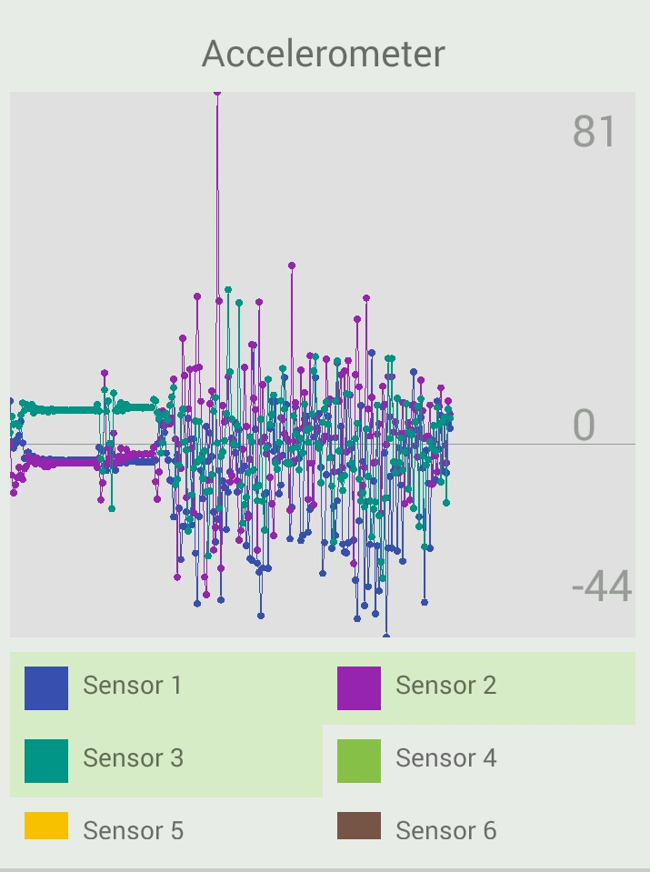
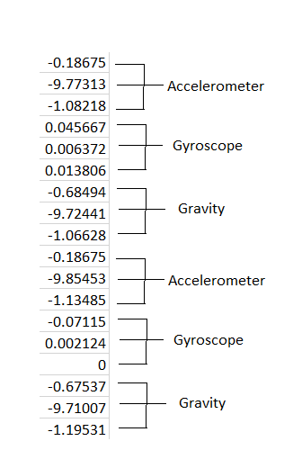
Values and Graphs

Slide 8
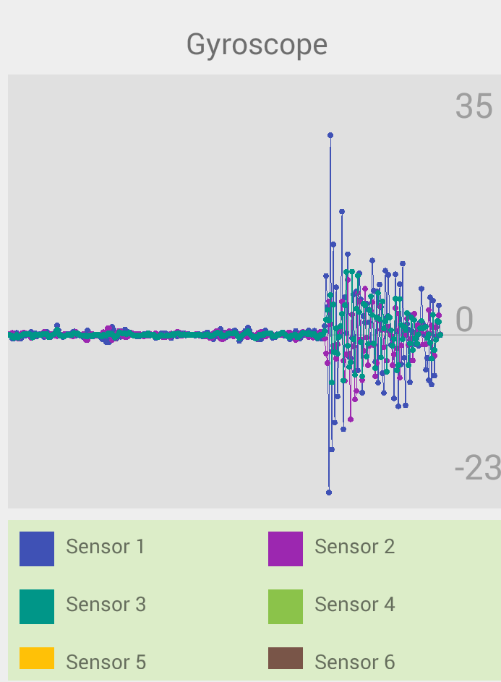
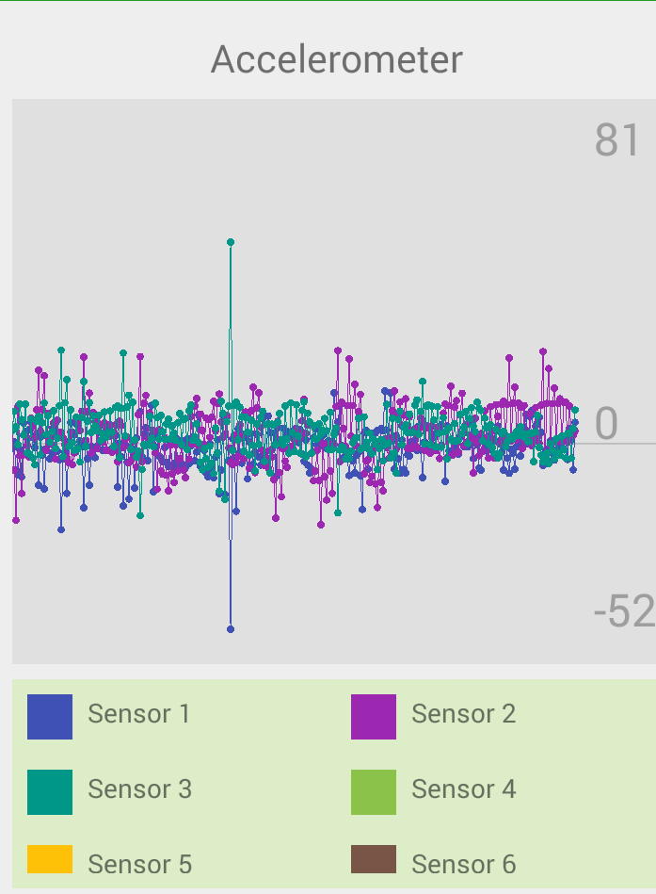
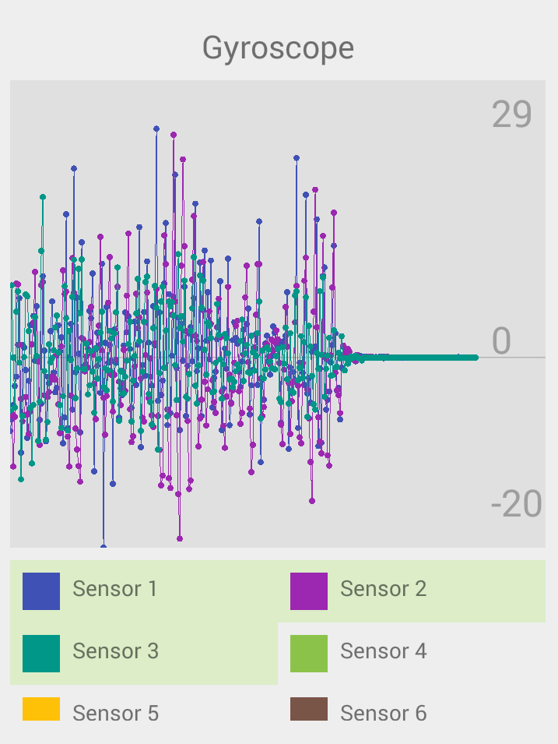

Slide 9
Future Work
Improving the UI of the app
More data collection point
Debugging the source code to improve the accuracy and remove if any error is generated
Working on sending data to the server for authentication and verification

